Slide 1


Pune Vidyarthi Griha's
COLLEGE OF ENGINEERING, TECHNOLOGY & MANAGEMENT, PUNE.
Artificial Intelligence & Data Science
AI-Based Medical Representative Visit Prioritization & Route Optimization System
Bhakti Jayantilal Gundecha (3071)
Parth Lokhande (1020)
Udaykiran Bitla (3056)
Internal Guide: Prof. Mrs. M. U. Buchade
Academic Year 2026-27
1

Slide 2
AI-Based Medical Representative Visit Prioritization & Route Optimization System
Introduction
What does a Medical Representative (MR) do?
A Medical Representative is a pharmaceutical field-sales professional who visits doctors, clinics, and hospitals to promote medications. In India, there are over 5 lakh MRs working across territories every day.
A typical MR's day:
Why is this harder than it looks?
Visiting 8 to 12 doctors in a single working day
Covering multiple locations across a territory
Working within each doctor's availability window
Prioritizing high-value doctors
Recording visit details and samples distributed
Reporting daily activity to managers
Every doctor has a different schedule and location
Some doctors are high-value, some are low-value
Travel between locations eats into productive time
Manual planning means the MR falls back on habit
Managers cannot see what is really happening
Our project tackles this workflow: which doctors should the MR visit, in what order, and when?
2

Slide 3
AI-Based Medical Representative Visit Prioritization & Route Optimization System
Problem Statement
MRs currently plan their daily doctor visits using manual methods: spreadsheets, memory, or fixed routes they repeat every cycle. This approach ignores real-time constraints like doctor availability, visit urgency, and geographic efficiency.
Specific problems:
High-priority doctors receive the same attention as low-priority ones (no scoring mechanism)
Routes are based on habit, not on shortest-path or time-window optimization
Doctor availability windows are tracked informally, leading to wasted trips
Managers lack visibility into field activity and cannot measure route efficiency
No feedback loop: yesterday's data does not improve today's plan
Time and fuel wasted on overlapping, inefficient travel paths
Problem Statement:
"How can AI-based priority prediction and constraint-based route optimization be integrated into a single web platform to automate and improve daily doctor-visit planning for Medical Representatives?"
3

Slide 4
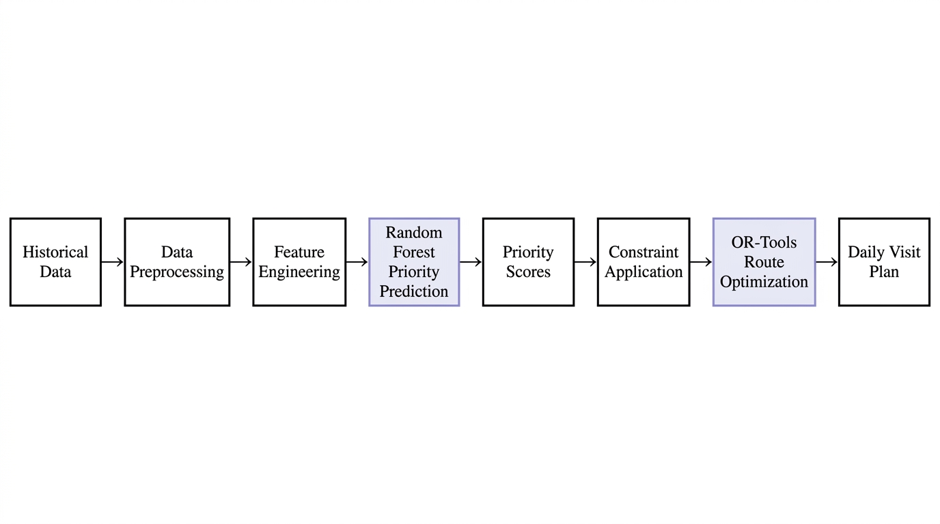
AI-Based Medical Representative Visit Prioritization & Route Optimization System
System Overview
Our system takes raw data about doctors, visits, and appointments, runs it through an ML model to score priorities, applies real-world constraints, and produces an optimized daily route.
Full Pipeline:
Three operating layers:
Layer | What It Does | Input | Output
Prediction | Random Forest scores each visit | Doctor and visit features | Priority score (0 to 1)
Constraint | Applies real-world scheduling rules | Time windows, working hours, visit durations | Feasible visit set
Optimization | OR-Tools solves VRPTW | Priority-weighted doctors + constraints | Ordered daily route
Each layer is modular and independently testable. The ML model and the optimizer can be evaluated, tuned, and replaced without affecting the other.
4

Slide 5
AI-Based Medical Representative Visit Prioritization & Route Optimization System
Literature Survey
Research Paper | Year | Key Point Handled / Proposed | Improvements Suggested
Zhang, Ohlmann & Thomas (European J. of OR) | 2014 | Models a pharma rep's daily visits as a stochastic orienteering problem with time windows. | Strong optimization but no ML-based priority prediction or web dashboard.
Bouatouche & Belkadi | 2025 | Hybrid Firefly + Local Search for sales-rep route planning with coordinates and time windows. | Algorithm/benchmark only. No priority scoring, no end-user application.
Liu, Chen, Por & Ku (Sustainability) | 2023 | Systematic review of 64 VRPTW studies. Most use metaheuristic methods. | General logistics domain. Not adapted for pharma MR constraints.
Ala & Chen | 2022 | Review of 150+ healthcare appointment scheduling papers including AI methods. | Focuses on patient scheduling, not pharmaceutical field-force routing.
Yi, Anandalingam & Sorrell (Expert Systems) | 2003 | Expert system for physician-detailing planning in pharma sales optimization. | Addresses sales effectiveness, not geographic route optimization.
Key gap: existing work isolates ML prediction, routing, or CRM visibility. Nobody integrates all three into one platform.
5

Slide 6
AI-Based Medical Representative Visit Prioritization & Route Optimization System
Literature Survey (continued)
Research Gap:
Existing research handles routing, prediction, or CRM management as isolated problems. Optimization papers focus on algorithms without building a usable application. ML papers predict priorities without connecting to route planning. Commercial CRM tools track visits but do not optimize them.
Feature | Manual Planning | Commercial CRM (Veeva) | Our Proposed System
Visit Priority Scoring | Based on gut feel | No ML-based scoring | Random Forest predicts score (0 to 1)
Route Optimization | Fixed familiar routes | No optimization engine | Google OR-Tools solves VRPTW
Time Window Constraints | Informal, often missed | Basic calendar view | Hard constraints in optimization model
Manager Visibility | End-of-day reports | Visit logs and reports | Real-time dashboards with route analytics
Data-Driven Feedback | None | Historical reports | ML model improves with more visit data
Our contribution: integrating predictive visit prioritization + constraint-based scheduling + route optimization into a single web platform for the Medical Representative workflow.
6

Slide 7
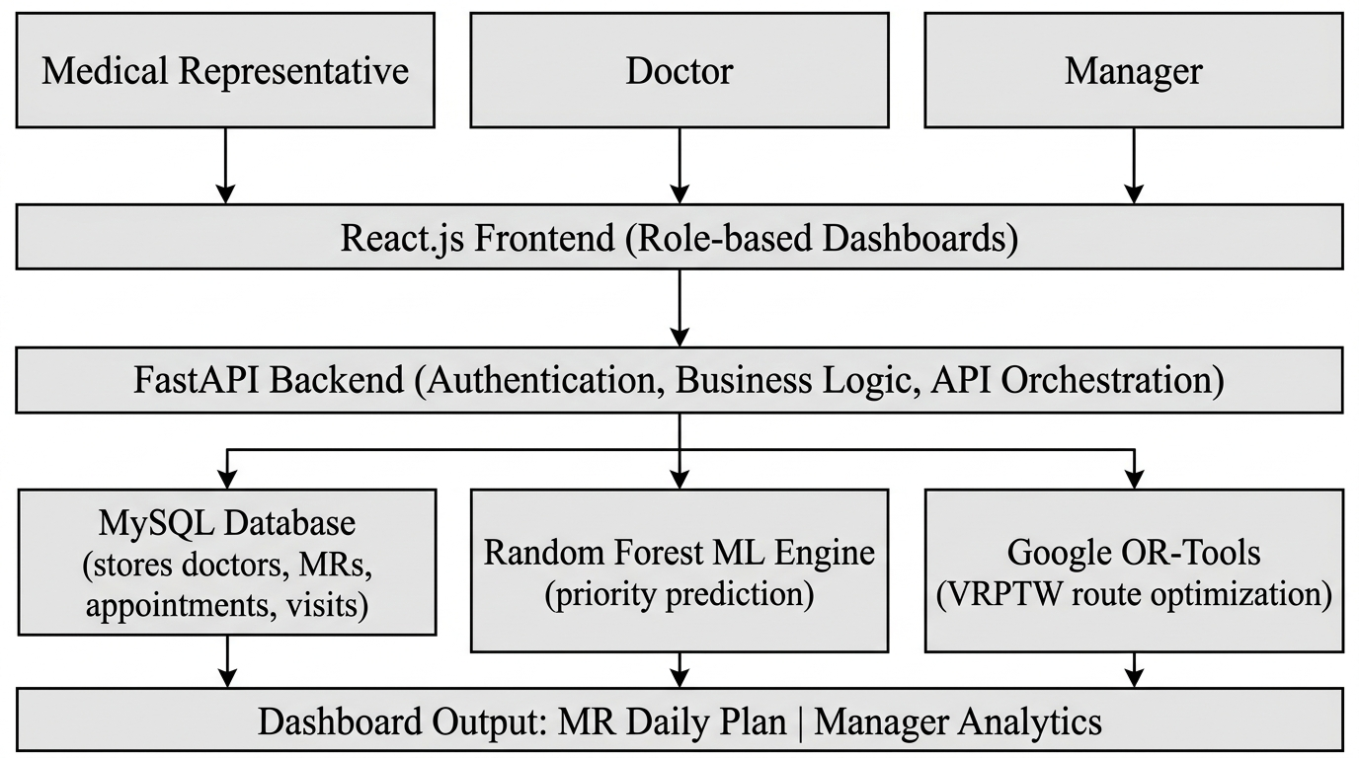
AI-Based Medical Representative Visit Prioritization & Route Optimization System
Architecture
Layered System Architecture:
v
React.js Frontend (role-based dashboards)
| REST APIs
v
FastAPI Backend (authentication, business logic, model orchestration)
|
v
Three backend services:
Key architectural decision: the ML model and OR-Tools are separate, independently testable modules. The backend orchestrates both. The model scores visits, the optimizer sequences them. Either can be improved or replaced without affecting the other.
7

Slide 8
AI-Based Medical Representative Visit Prioritization & Route Optimization System
Software Requirements
Non-Functional Requirements:
NFR1: API response time under 3 seconds
NFR2: Support up to 50 doctors per territory
NFR3: Role-based access control on all endpoints
NFR4: Responsive web UI (desktop and tablet)
NFR5: Input validation on all forms
NFR6: Secure password storage (bcrypt)
NFR7: Handle concurrent MR requests
NFR8: Database backup capability
Functional Requirements:
FR1: User registration and role-based login (MR, Manager, Doctor)
FR2: Doctor profile management (specialty, location, availability)
FR3: MR profile and territory management
FR4: Appointment creation with time-window constraints
FR5: ML-based visit priority prediction (Random Forest)
FR6: Optimized daily route generation (OR-Tools VRPTW)
FR7: MR dashboard showing optimized daily plan
FR8: Manager dashboard with team-wide analytics
FR9: Visit logging and history tracking
FR10: Report generation (visits, routes, performance)
Hardware Requirements:
Intel i5 or equivalent processor
8 GB RAM minimum, 16 GB preferred
SSD, 50 GB+ free space
Stable internet connection
8

Slide 9
AI-Based Medical Representative Visit Prioritization & Route Optimization System
Design / Algorithms / Techniques
1. Random Forest Classifier:
2. VRPTW (Google OR-Tools):
Ensemble of 100-500 decision trees
Each tree trained on a bootstrap sample
Final prediction by majority vote
Handles mixed feature types (categorical + numerical)
Provides feature importance rankings
Classifies visits as High / Medium / Low priority
Vehicle Routing Problem with Time Windows
Input: locations, travel times, service durations, time windows
Goal: minimum-cost route visiting all locations within time windows
MR working hours as outer constraint (9 AM to 6 PM)
Priority score from RF used as visit weight
Output: ordered visit sequence with arrival times
3. Feature Engineering Pipeline:
Feature | Type | Source | Purpose
Days since last visit | Numerical | Visit history | Recency indicator
Visit frequency (monthly) | Numerical | Visit logs | Engagement level
Doctor specialty | Categorical | Doctor profile | Some specialties need more visits
Prescription volume | Numerical | Sales data | High-volume = higher priority
Geographic distance | Numerical | Location data | Travel cost for optimization
Availability window | Time range | Appointment data | Hard constraint for VRPTW
9

Slide 10
AI-Based Medical Representative Visit Prioritization & Route Optimization System
Modules Split-Up
The system has 8 independent modules:
Module | Responsibility | Key Technologies
M1: Data Management | Doctor profiles, MR records, visit history, appointment data | MySQL, FastAPI CRUD
M2: User Authentication | Registration, login, role-based access control | FastAPI, JWT, bcrypt
M3: Data Preprocessing | Cleaning, encoding, normalization, train/test splits | Pandas, NumPy, Scikit-learn
M4: ML Priority Engine | Random Forest training, prediction, evaluation | Scikit-learn, joblib
M5: Constraint Engine | Doctor time windows, MR hours, visit durations | Python constraint logic
M6: Route Optimizer | VRPTW formulation and solving | Google OR-Tools
M7: Frontend Dashboards | MR daily plan, manager analytics, doctor schedule | React.js, Axios, Chart.js
M8: Reporting Module | Visit reports, route metrics, CSV/PDF export | FastAPI endpoints
Modules M4, M5, and M6 form the core intelligence pipeline. Each module has clear inputs and outputs.
10

Slide 11
AI-Based Medical Representative Visit Prioritization & Route Optimization System
Proposed System
How a daily visit plan gets generated, step by step:
Step 1: MR logs into the dashboard. System pulls territory data from MySQL.
Step 2: Preprocessing cleans the data (missing values, encoding, normalization).
Step 3: Feature engineering extracts signals: days since last visit, visit frequency, prescription volume, distance.
Step 4: Random Forest scores each doctor visit with a priority between 0 (low) and 1 (high).
Step 5: Constraint engine applies rules: Doctor A only available 10-12, Doctor B needs 30-min visits, MR works 9 to 6.
Step 6: OR-Tools takes priority-weighted doctors and constraints, solves VRPTW, produces optimized sequence.
Step 7: MR sees the final daily plan on the dashboard: doctors in visit order with estimated arrival times.
What makes this different from existing approaches:
Data-driven priority, not gut-feel ranking
Time-window aware routing, not just shortest path
Integrated pipeline, not separate disconnected tools
Manager visibility through dashboards
11

Slide 12
AI-Based Medical Representative Visit Prioritization & Route Optimization System
Software Tools and Technologies
Category | Technology | Why We Chose It
Language | Python 3.x | Rich ML ecosystem, OR-Tools support, FastAPI compatibility
Frontend | React.js | Component-based UI, large community, fast dashboard rendering
Backend | FastAPI | Async support, auto-generated docs, type validation
Database | MySQL | Relational structure fits our data model, ACID compliance
ML | Scikit-learn | Built-in Random Forest, pipeline support, evaluation metrics
Data Processing | Pandas, NumPy | Industry standard for tabular data work
Optimization | Google OR-Tools | Production-grade VRPTW solver, well-documented Python API
Version Control | Git / GitHub | Collaboration, branching, code review
IDE | Visual Studio Code | Lightweight, extensible, integrated terminal
Deployment | Cloud (TBD) | Scalable hosting for web app and API
12

Slide 13
AI-Based Medical Representative Visit Prioritization & Route Optimization System
Proposed Outcome
Three-level evaluation:
ML Model Evaluation:
Route Evaluation:
System Evaluation:
Accuracy
Precision
Recall
F1-Score
Confusion matrix
Total travel distance (km)
Total travel time
Visits completed per day
Time-window violations
Idle/waiting time
% improvement over baseline
API response time (under 3 sec)
Route generation time
Dashboard load time
Role-based access enforcement
Data validation coverage
These are evaluation criteria and planning targets. We will not claim specific improvement percentages until we have measured experimental evidence. The baseline for route comparison will be a nearest-neighbour heuristic and a simulated manual planning approach.
13

Slide 14
AI-Based Medical Representative Visit Prioritization & Route Optimization System
Feasibility and Scope
Current Scope:
Feasibility Analysis:
Single-MR, single-territory optimization
Random Forest for priority prediction
Google OR-Tools for VRPTW
Role-based web dashboard (MR + Manager)
MySQL database
FastAPI REST endpoints
Three-level evaluation
Technical:
Python ecosystem provides all required libraries. RF is well-understood. OR-Tools has production-grade solvers. React and FastAPI are mature frameworks.
Operational:
MRs only need a web browser. No specialized hardware required on the client side.
Future Scope:
Economic:
All tools and libraries are open-source and free. No licensing costs.
Multi-MR, multi-territory optimization
Real-time re-routing on cancellations
Mobile application for field use
Integration with live traffic data
Schedule:
17-week timeline mapped to specific deliverables with buffer time for integration.
14

Slide 15
AI-Based Medical Representative Visit Prioritization & Route Optimization System
Project Plan 2.0
Updated Five-Phase Delivery Timeline:
Phase | Duration | Deliverables | Milestone
Phase 1: Research and Data | Weeks 1-4 | Literature survey, dataset acquired, preprocessing pipeline built | Dataset ready for ML training
Phase 2: ML Development | Weeks 5-8 | Random Forest trained and evaluated, model serialized | Priority model achieving target accuracy
Phase 3: Optimization Engine | Weeks 8-10 | VRPTW formulation, OR-Tools integration, route testing | Optimizer generates valid routes
Phase 4: Web Application | Weeks 10-14 | FastAPI backend, MySQL schema, React frontend, dashboards | Full web app running in development
Phase 5: Integration and Testing | Weeks 14-17 | End-to-end pipeline, system testing, evaluation, documentation | Complete working system
This is Project Plan 2.0, refined based on Review-I feedback. Main change: overlapping phases 3 and 4 for parallel development.
15

Slide 16
AI-Based Medical Representative Visit Prioritization & Route Optimization System
References
[1] J. C. Yi et al., "An expert system to physician-detailing planning," Expert Systems with Applications, 2003.
[2] S. Zhang et al., "A priori orienteering with time windows and stochastic wait times," European J. of OR, 2014.
[3] A. Bouatouche and A. Belkadi, "A hybrid firefly algorithm for the sales representative planning problem," 2025.
[4] X. Liu et al., "A Systematic Literature Review of VRPTW," Sustainability, 2023.
[5] A. Ala and F. Chen, "Appointment Scheduling Problem in Healthcare Services," 2022.
[6] Google OR-Tools Documentation, "VRPTW."
[7] F. Pedregosa et al., "Scikit-learn: Machine Learning in Python," JMLR, 2011.
[8] S. Ramirez, "FastAPI Documentation," https://fastapi.tiangolo.com/
[9] React.js Documentation, https://react.dev/
[10] MySQL Reference Manual, https://dev.mysql.com/doc/
16

Slide 17
Thank You
Questions & Suggestions Welcome
17

